Slide 1
18CSE390T
Computer Vision
S1 - SLO-2 -Snakes

Slide 2
Active Contours (Snake)
First introduced in 1987 by Kass et al, and gained popularity since then.
Represents an object boundary or some other salient image feature as a parametric curve.
An energy functional E is associated with the curve.
The problem of finding object boundary is cast as an energy minimization problem

Slide 3
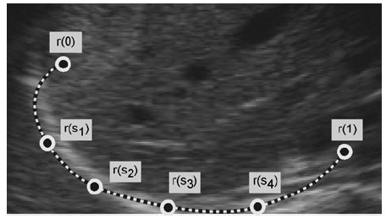
A Snake is a parametric

Slide 4
Active Contours (Snake)
The course of the snake smoothly follows high intensity gradients if the gradients reliably reflect the object boundary.
Asmooth boundary is generated bridging regions of noisy data or missing gradients.
Active contour is particularly well suited to segment an object instance in an image where the data are distorted by noise

Slide 5

Frameworks for Snakes
A higher level process or a user initializes any curve close to the object boundary.
The snake then starts deforming and moving towards the desired object boundary.
In the end it completely “shrink-wraps” around the object

Slide 6
Deformable Models
Deformable models are curves or surfaces defined within an image domain that can move under the influence of internal forces, which are defined within the curve or surface itself, and external forces, which are computed from the image data.
The internal forces are designed to keep the model smooth during deformation.
The external forces are defined to move the model toward an object boundary or other desired features within an image.

Slide 7
Active Contour Modeling
The contour is defined in the (x, y) plane of an image as a parametric curve
ν( s ) = ( x( s ), y( s )) 0 ≤ s ≤ 1
Contour is said to possess an energy (E_{snake}) which is defined as the sum of the three energy terms.
^{E}snake ^{= E}int ernal ^{+ E}external ^{+ E}constra int
The energy terms are defined cleverly in a way such that the final position of the contour will have a minimum energy (E_{min})
Therefore our problem of detecting objects reduces to an energy minimization problem.

Slide 8
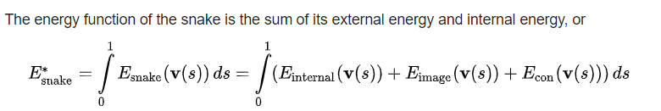
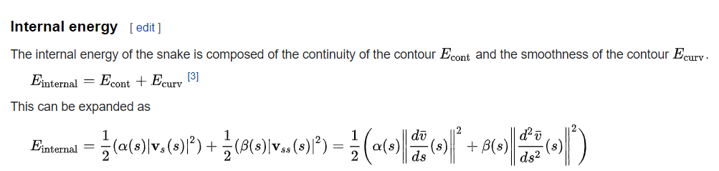
INTERNAL ENERGY

Slide 9
Elastic nets and slippery springs
An interesting variant on snakes- Elastic net
Elastic net formulation of the Traveling Salesman Problem (TSP).
A snake that is constrained to pass through each city could solve this problem (without any optimality guarantees) but it is impossible to tell ahead of time which snake control point should be associated with each city

Slide 10
Problems with Snakes
Depends on number and spacing of control points
Snake may over-smooth the boundary
Initialization is crucial
Not trivial to prevent curve self intersecting
May not follow topological changes of Objects

